Slide 1
Trauma, PTSD & Traumatic Grief
Jamie Marich, Ph.D., LPCC-S, LICDC-CS
Youngstown/Warren, OH
Affiliate Faculty, International Association of Trauma Professionals

Slide 2
About Your Presenter
Licensed Supervising Professional Clinical Counselor
Licensed Independent Chemical Dependency Counselor
Affiliate Faculty, International Association of Trauma Professionals (IATP)
13 years of experience working in social services and counseling; includes three years in civilian humanitarian (Bosnia-Hercegovina)
Specialist in addictions, trauma, EMDR, dissociation, performance enhancement, grief/loss, mindfulness, and pastoral counseling
Author of EMDR Made Simple, Trauma and the Twelve Steps, and Trauma Made Simple (forthcoming)
Creator of the Dancing Mindfulness practice

Slide 3
What led you to today’s workshop?

Slide 4
Learning Objectives
Describe the etiology and impact of traumatic stress on the client utilizing evaluation tools.
Assess a client’s reaction to a traumatic event, Acute Stress Disorder and PTSD
Explain the DSM-5® changes as they relate to both PTSD and grief-related disorders
Implement interventions to assist a client in dealing with the physical manifestations of trauma/PTSD/traumatic grief
Utilize appropriate evidence-based interventions to assist a client in dealing with the psycho/socio/emotional manifestations of trauma/PTSD/traumatic grief
Explain the effect of trauma on the structure and function of the brain

Slide 5
www.traumatwelve.com/powerpoint

Slide 6

Trauma

Slide 7
“Once you’ve been bitten by a snake, you’re afraid even of a piece of rope.”
-Chinese Proverb

Slide 8
Etymology
What does the word trauma mean?

Slide 9
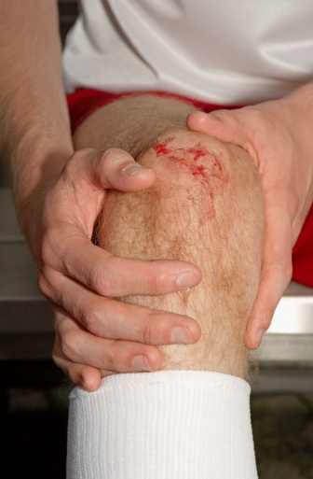
Etymology
Trauma comes from the Greek word meaning wound
What do we know about physical wounds and how they heal?

Slide 10
Etymology
Appreciating the wound metaphor is the heart of understanding emotional trauma and how to treat it.

Slide 11
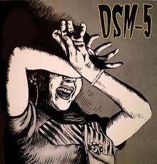

Slide 12
DSM
PTSD entered into the DSM-III in 1980, largely as a result of the Vietnam War
Other names had been used unofficially in the field over the years:
soldier’s heart
shell shock
battle fatigue
operational exhaustion
hysteria

Slide 13
DSM-IV-TR Nutshell Definition of PTSD
Posttraumatic Stress Disorder
(APA, 2000)
Actual or perceived threat of injury or death- response of hopelessness or horror (Criterion A)
Re-experiencing of the trauma
Avoidance of stimuli associated with the trauma
Heightened arousal symptoms
Duration of symptoms longer than 1 month
Functional impairment due to disturbances

Slide 14
DSM-5® Nutshell Definition of PTSD
Posttraumatic Stress Disorder
(APA, 2013)
Exposure to actual or threatened a) death, b) serious injury, or c) sexual violation: direct experiencing, witnessing
Intrusion symptoms
Avoidance of stimuli associated with the trauma
Cognitions and Mood: negative alterations
Arousal and reactivity symptoms
Duration of symptoms longer than 1 month
Functional impairment due to disturbances

Slide 15
Posttraumatic Stress Disorder:
DSM-5® Criteria
Exposure to actual or threatened death, serious injury, or sexual violence, in one (or more) of the following ways:
Directly experiencing the traumatic event(s).
Witnessing, in person, the traumatic event(s) as it occurred to others.
Learning that the traumatic event(s) occurred to a close family member or close friend; cases of actual or threatened death must have been violent or accidental.
Experiencing repeated or extreme exposure to aversive details of the traumatic event(s) (e.g., first responders collecting human remains; police officers repeatedly exposed to details of child abuse); this does not apply to exposure through electronic media, television, movies, or pictures, unless this exposure is work-related.

Slide 16
Posttraumatic Stress Disorder:
DSM-5® Criteria
B. Presence of one (or more) of the following intrusion symptoms associated with the traumatic event(s), beginning after the traumatic event(s) occurred:
Recurrent, involuntary, and intrusive distressing memories of the traumatic event(s). (Note: In children older than 6 years, repetitive play may occur in which themes or aspects of the traumatic event(s) are expressed.)
Recurrent distressing dreams in which the content and/or affect of the dream are related to the traumatic event(s). (Note: In children, there may be frightening dreams without recognizable content.)
Dissociative reactions (e.g., flashbacks) in which the individual feels or acts as if the traumatic event(s) are recurring. (Such reactions may occur on a continuum, with the most extreme expression being a complete loss of awareness of present surroundings.) (Note: In children, trauma-specific reenactment may occur in play.)
Intense or prolonged psychological distress at exposure to internal or external cues that symbolize or resemble an aspect of the traumatic event(s).
Marked physiological reactions to internal or external cues that symbolize or resemble an aspect of the traumatic event(s).reminders of the traumatic event(s)

Slide 17
Posttraumatic Stress Disorder:
DSM-5® Criteria
C. Persistent avoidance of stimuli associated with the traumatic event(s), beginning after the traumatic event(s) occurred, as evidenced by one or both of the following:
Avoidance of or efforts to avoid distressing memories, thoughts, or feelings about or closely associated with the traumatic event(s).
Avoidance of or efforts to avoid external reminders (people, places, conversations, activities, objects, situations) that arouse distressing memories, thoughts, or feelings about or closely associated with the traumatic event(s).

Slide 18
Posttraumatic Stress Disorder:
DSM-5® Criteria
D. Negative alterations in cognitions and mood associated with the traumatic event(s), beginning or worsening after the traumatic event(s) occurred, as evidenced by two (or more) of the following:
Inability to remember an important aspect of the traumatic event(s) (typically due to dissociative amnesia and not to other factors such as head injury, alcohol, or drugs)
Persistent and exaggerated negative beliefs or expectations about oneself, others, or the world (e.g., “I am bad,” “No one can be trusted,” "The world is completely dangerous,“ “My whole nervous system is permanently ruined”).
Persistent, distorted cognitions about the cause or consequences of the traumatic event(s) that lead the individual to blame himself/herself or others.
Persistent negative emotional state (e.g., fear, horror, anger, guilt, or shame).
Markedly diminished interest or participation in significant activities.
Feelings of detachment or estrangement from others.
Persistent inability to experience positive emotions (e.g., inability to experience happiness, satisfaction, or loving feelings).

Slide 19
Posttraumatic Stress Disorder:
DSM-5® Criteria
E. Marked alterations in arousal and reactivity associated with the traumatic event(s), beginning or worsening after the traumatic event(s) occurred, as evidenced by two (or more) of the following:
Irritable behavior and angry outbursts (with little or no provocation) typically expressed as verbal or physical aggression toward people or objects.
Reckless or self-destructive behavior.
Hypervigilance.
Exaggerated startle response.
Problems with concentration.
Sleep disturbance (e.g., difficulty falling or staying asleep or restless sleep).

Slide 20
Posttraumatic Stress Disorder:
DSM-5® Criteria
F. Duration of the disturbance (Criteria B, C, D, and E) is more than 1 month.
G. The disturbance causes clinically significant distress or impairment in social, occupational, or other important areas of functioning.
H. The disturbance is not attributable to the physiological effects of a substance (e.g., medication, alcohol) or another medical condition.

Slide 21
Posttraumatic Stress Disorder:
DSM-5® Criteria
Specify whether:
With dissociative symptoms: The individual’s symptoms meet the criteria for posttraumatic stress disorder, and in addition, in response to the stressor, the individual experiences persistent or recurrent symptoms of either of the following:
Depersonalization: Persistent or recurrent experiences of feeling detached from, and as if one were an outside observer of, one’s mental processes or body (e.g., feeling as though one were in a dream; feeling a sense of unreality of self or body or of time moving slowly).
Derealization: Persistent or recurrent experiences of unreality of surroundings (e.g., the world around the individual is experienced as unreal, dreamlike, distant, or distorted).
Note: To use this subtype, the dissociative symptoms must not be attributable to the physiological effects of a substance (e.g., blackouts, behavior during alcohol intoxication) or another medical condition (e.g. complex partial seizures).
Specify if:
With Delayed Expression: If the full diagnostic criteria are not met until at least 6 months after the event (although the onset and expression of some symptoms may be immediate).
Subtype: PTSD in children younger than 6 years

Slide 22
DSM-5®:
Trauma & Stressor-Related Disorders
Reactive Attachment Disorder
Disinhibited Social Engagement Disorder
Acute Stress Disorder
Posttraumatic Stress Disorder
Adjustment Disorders
Other Specified Trauma-and-Stressor Related Disorder
Unclassified Trauma-and-Stressor Related Disorder

Slide 23

Trauma: “small-t”
Adverse life experiences
Not necessarily life threatening, but definitely life-altering
Examples include grief/loss, divorce, verbal abuse/bullying, and just about everything else…
The trauma itself isn’t the problem—rather, does it get addressed? Is the wound given a chance to heal?
If it was traumatic to the person, then it’s traumatic.
According to the adaptive information processing model, these adverse life experiences can be just as valid and just as clinically significant as PTSD-eligible traumas.

Slide 24
BREAK TIME

Slide 25
Worden (2002/2008)
Grief is the experience of loss in one’s life
Bereavement defines the loss to which a person is trying to adapt
Mourning is the process one goes through adapting to the loss
Complicated mourning: when the adaptation is insufficient, it leads to functional impairment

Slide 26
George Engel, M.D. (1961)
“Loss of a loved one is psychologically traumatic to the same extent that being severely wounded or burned is physiologically traumatic.”
→ The process of mourning is parallel to the process of physical healing.

Slide 27
Grief, Mourning & DSM-5®
Removal of the bereavement exclusion from the major depressive disorder diagnosis
New Section III Diagnosis:
Persistent Complex Bereavement Disorder

Slide 28
Persistent Complex Bereavement Disorder: DSM-5® Criteria
A. The individual experienced the death of someone with whom he or she had a close relationship.
B. Since the death, at least one of the following symptoms is experienced on more days than not and to a clinically significant degree and has persisted for at least 12 months after the death in the case of bereaved adults and 6 months for bereaved children:
Persistent yearning/longing for the deceased. In young children, yearning may be expressed in play and behavior, including behaviors that reflect being separated from, and also reuniting with, a caregiver or other attachment figure.
Intense sorrow and emotional pain in response to the death.
Preoccupation with the deceased.
Preoccupation with the circumstances of the death. In children, this preoccupation with the deceased may be expressed through the themes of play and behavior and may extend to preoccupation with possible death of others close to them.

Slide 29
Persistent Complex Bereavement Disorder: DSM-5® Criteria
C. Since the death, at least six of the following symptoms are experienced on more days than not and to a clinically significant degree, and have persisted for at least 12 months after the death in the case of bereaved adults and 6 months for bereaved children:
Reactive distress to the death
Marked difficulty accepting the death. In children, this is dependent on the child’s capacity to comprehend the meaning and permanence of death.
Experiencing disbelief or emotional numbness over the loss.
Difficulty with positive reminiscing about the deceased.
Bitterness or anger related to the loss.
Maladaptive appraisals about oneself in relation to the deceased or the death (e.g., self-blame).
Excessive avoidance of reminders of the loss (e.g., avoidance of individuals, places, or situations associated with the deceased); in children, this may include avoidance of thoughts and feelings regarding the deceased.

Slide 30
Persistent Complex Bereavement Disorder: DSM-5® Criteria
Social/Identity Disruption
7. A desire to die in order to be with the deceased.
8. Difficulty trusting other individuals since the death.
9. Feeling alone or detached from other individuals since the death.
10. Feeling that life is meaningless or empty without the deceased, or the belief that one cannot function without the deceased.
11. Confusion about one’s role in life or a diminished sense of one’s identity (e.g., feeling that a part of oneself died with the deceased).
12. Difficulty or reluctance to pursue interests since the loss or to plan for the future (e.g., friendships, activities).

Slide 31
Persistent Complex Bereavement Disorder: DSM-5® Criteria
D. The disturbance causes clinically significant distress or impairment in social, occupational, or other important areas of functioning.
E. The bereavement reaction is out of proportion to or inconsistent with cultural, religious, or age-appropriate norms.
Specify if:
With Traumatic Bereavement: bereavement due to homicide or suicide with persistent distressing preoccupations regarding the traumatic nature of the death (often in response to loss reminders), including the deceased’s last moments, degree of suffering and mutilating injury, or the malicious or intentional nature of the death

Slide 32
The Classic Kübler-Ross (1969) “Stages”
Denial
Anger
Bargaining
Depression
Acceptance
Have you ever thought of a client as being stuck in this process?

Slide 33
A Client’s Perspective:
Lily Burana (2009)
“That whole Kubler-Ross thing? The separate stages of Denial, Anger, Bargaining, Dorothy and Toto, or whatever? TOTAL CRAP. What you get when someone dies is all those feelings ALL AT ONCE, warping and spinning around like grief’s bad trip.”

Slide 34


Slide 35
A Client’s Perspective:
Lily Burana (2009)
“PTSD means, in ‘talking over beer’ terms, that you’ve got some crossed wires in your brain due to the traumatic event. The overload of stress makes your panic button touchier than most people’s, so certain things trigger a stress reaction- or more candidly- an over-reaction. Sometimes, the panic button gets stuck altogether and you’re in a state of constant alert, buzzing and twitchy and aggressive.”

Slide 36
A Client’s Perspective:
Lily Burana (2009)
“Your amygdala- the instinctive flight, fight, or freeze part of your brain- reacts to a trigger before your rational mind can deter it. You can tell yourself, ‘it’s okay,’ but your wily brain is already ten steps ahead of the game, registering danger and sounding the alarm. So you might say once again, in a calm, reasoned cognitive-behavioral-therapy kind of way, ‘Brain, it’s okay…’

Slide 37
A Client’s Perspective:
Lily Burana (2009)
“But your brain yells back, ‘Bullshit kid, how dumb do you think I am? I’m not falling for that one again.’ By then, you’re hiding in the closet, hiding in a bottle, and/or hiding from life, crying, raging, or ignoring the phone and watching the counter on the answering machine go up, up, up, and up. You can’t relax, and you can’t concentrate because the demons are still pulling at your strings.”

Slide 38
A Client’s Perspective:
Lily Burana (2009)
“The long-range result is that the peace of mind you deserve in the present is held hostage by the terror of your past.”

Slide 39
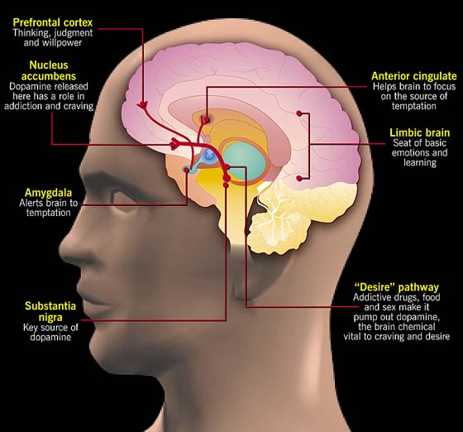

Slide 40
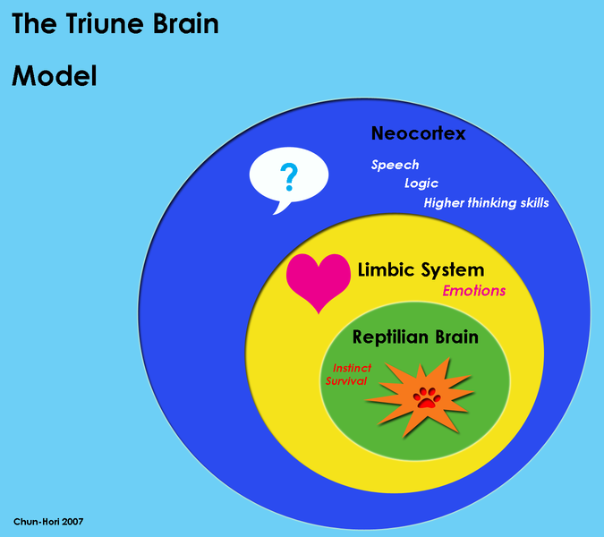

Slide 41
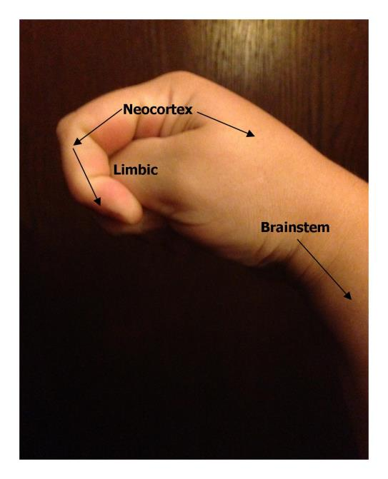

Slide 42
Putting it Simply
Cognitive-behavioral, talk therapies primarily target the prefrontal regions of the brain (e.g., thinking, judgment, and willpower).
However, when a person gets activated or triggered by traumatic memories or other visceral experiences, the prefrontal cortex is likely to shut down and the limbic brain (e.g., emotional brain) takes over.
Just talking can activate the emotional, limbic brain, but just talking is not very likely to calm it back down.
What does not seem to change with traditional talk therapy is that uncomfortable experience of being triggered at a visceral level.

Slide 43
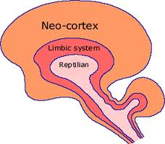
Putting it Simply
Thus, our therapeutic interventions must address the entire brain.
Another way to look at processing is to think of these three brains “linking up.”

Slide 44

What Does it Mean to Process Something???

Slide 45
Trauma and the Adaptive
Information Processing Model (Part I)
Memory networks are the basis of perception, attitude and behavior…they inform the present.
The information processing system moves disturbance to an adaptive resolution…the events that don’t get processed through adaptively give us problems later in life.
Disruption of the information processing system causes information (e.g., seen, heard, felt) to be unprocessed and inappropriately stored as it was perceived.
(SOURCE: Shapiro, 2001; Shapiro & Solomon, 2008)

Slide 46

Unprocessed and inappropriately stored as it was perceived =
STUCK material that causes disturbance

Slide 47

How can something then get “unstuck”?

Slide 48
Trauma and the Adaptive
Information Processing Model (Part II)
Accessing information allows link between consciousness and where information is stored
Information processing transmutes through all accessed channels of memory networks
The unprocessed components/manifestations of memory (image, thought, sound, emotions, physical sensations, beliefs) change/transmute during processing to an adaptive resolution
(SOURCE: Shapiro, 2001; Shapiro & Solomon, 2008)

Slide 49
Trauma and the Adaptive
Information Processing Model (Part III)
Byproducts of reprocessing include desensitization (lessening of disturbance), insights, changes in physical and emotional responses
(SOURCE: Shapiro, 2001; Shapiro & Solomon, 2008)

Slide 50
A Client’s Perspective: from Marich (2010)
Fadalia (pseudonym), a recovering heroin addict with complex trauma reflected on where she was at before receiving the integrated treatment that led to her longest sobriety to date (3 years):
“Before [treatment], my feelings, thoughts and experiences were all tangled like a ball of yarn. I needed something to untangle them.”

Slide 51


➔

Slide 52
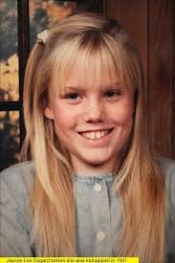
From Jaycee Dugard (2011)
“This book might be confusing to some. But keep in mind throughout my book that this was a very confusing world I lived in. I think to truly begin to understand what it was like, you would have had to be there, and since I wish that on no one, this book is my attempt to convey the overwhelming confusion I felt during those years and to begin to unravel the damage that was done to me and my family.

Slide 53
From Jaycee Dugard (2011)
You might be suddenly reading about a character that was never introduced , but that’s how it was for me. It didn’t feel like a sequence of events. Even after I was freed, moments are fragmented and jumbled. With some help, I have come to realize that my perspective is unique to abduction. I don’t want to lose that voice, and therefore I have written the book how it came to me naturally. I’m not the average storyteller…I’m me…and my experience is very uncommon. Yes, I jump around with tangents, but that’s somehow the way my mind works. If you want a less confusing story, come back to me in ten years from now when I sort it all out!” (p. viii).

Slide 54
Assessment as Intervention

Slide 55
Primary Care PTSD Screen
The PTSD Checklist
Catalogue of Resources on the National Center for PTSD Website
http://www.ptsd.va.gov/

Slide 56

How Do I Expand My Addiction Knowledge,
Even If I’m Not an “Addiction” Provider?

Slide 57

Ricci and Clayton (2008)
“Trauma may also disintegrate any sense of a future, thus fostering a propensity for the pursuit of instant gratification” (p. 42).

Slide 58
Assessment Strategy
The “Greatest Hits” List of Problematic Beliefs
The “Greatest Hits” List of Addiction-Specific Beliefs
Sometimes it is difficult for clients to pinpoint one specific memory in addressing trauma. However, they are more likely to be able to select a pattern of thoughts they have had about themselves after seeing these lists. This is often a good starting point to developing a treatment plan.

Slide 59

"When tragedies strike we try to find someone to blame, and in the absence of a suitable candidate we usually blame ourselves.”
-Maggie Smith, as The Dowager Countess of Grantham

Slide 60

“The Whitney I knew, despite her success and worldwide fame, still wondered: Am I good enough? Am I pretty enough? Will they like me?
It was the burden that made her great . . .
So off you go, Whitney, off you go . . . escorted by an army of angels to your Heavenly Father. And when you sing before Him, don’t you worry — you’ll be good enough.”
-from Kevin’s Costner’s eulogy

Slide 61

February 20, 1968
Dear Mother—
From all indications I’m going to become rich and famous. All sorts of magazines are asking to do articles and pictures featuring me. I’m going to do every one. Wow, I’m so lucky- I just fumbled around being a mixed up kid and then I fell into this. And finally it looks like everything is going to work out for me.
I’m awfully sorry to be such a disappointment to you. I understand your fears at my coming here and must admit I share them, but I really do think there’s an awfully good chance I won’t blow it this time. There’s really nothing more I can say now. Guess I’ll write more when I have more news, until then, address all criticism to the above address. And please believe me that you can’t possibly want for me to be a winner more than I do.
Love, Janis
Source: Joplin, L. (2004)

Slide 62
Best Practices for Assessment
Do not re-traumatize!
Do ask open-ended questions
Do be genuine, build rapport from the first greeting
Do consider the role of shame in addiction, trauma, and grief
Do be non-judgmental
Do make use of the stop sign when appropriate
Do assure the client that they may not be alone in their experiences (if appropriate)
Do have closure strategies ready

Slide 63

Now It’s Your Turn
Write up a brief case synopsis:
An actual client (using a pseudonym)
A composite client
A “famous” example (presenting for clinical attention)
A fictitious case

Slide 64

Discussion:
Your Reactions and Experiences

Slide 65

“When we honestly ask ourselves which person in our lives means the most to us, we often find that it is those who, instead of giving advice, solutions, or cures, have chosen rather to share our pain and touch our wounds with a warm and tender hand.”
-Henri Nouwen

Slide 66
The Case of Anna: Qualities of a Good Therapist (Marich, 2014)
To know and understand a client’s diagnosis.
To get to know you, where you're at (are you externally and internally safe???), where you've come from (historical context; triggers, traumas, what to be aware of), and where you want to go (short- and long-term goals).
To be a person who believes in TEAMWORK. Both the professional and the client do work, lots of it. There is not an aggressor in the equation, ever. When/if it happens, stop.

Slide 67
The Case of Anna: Qualities of a Good Therapist (Marich, 2014)
To have compassion and empathy—NOT PITY, ever. I have seen pathological psychiatrists who don't like humans. Pity is just destructive to what is supposed to be happening: growth and healing. Pity is never a foundation for that.
To have a sense of connectedness. For people without a diagnosis, when they're going through a hard time, the baseline is to find someone you connect with.
To never, never, never put their own moral thing (e.g., Christianity) above the code of treatment. Ever!!!!! No dogma at all should be in the way of the client finding her way.

Slide 68
The Case of Anna: Qualities of a Good Therapist (Marich, 2014)
“Bad therapy is worse than no therapy. I have learned this experientially.”
-Anna

Slide 69
Please Return by 1:00pm

Slide 70
www.traumatwelve.com/powerpoint

Slide 71

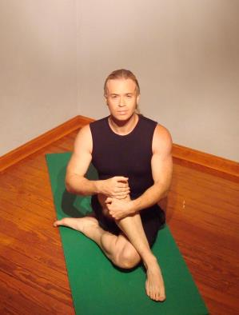

TREATMENT

Slide 72
From Dr. Bessel Van Der Kolk
“The purpose of trauma treatment is to help a person feel safe in his or her own body.”
-from the new documentary
Trauma Treatment for the 21st Century (Premier, 2012)

Slide 73
General Consensus Model of Trauma Treatment
PHASE I: Stabilization
PHASE II: Processing of Trauma
PHASE III: Reintegration

Slide 74
Guiding Principles
Before any clinician can engage in past-oriented trauma treatments focused on resolution, a set of coping skills must be in place.
It is vital that a person has tools to cope with intense affect, and it is equally vital that he/she will not come “unglued” during processing/reprocessing work.
Cultivation of resources, strengths, and other recovery capital is also an essential function of reintegration
Therapeutic relationship elements and boundary setting are also imperative

Slide 75
Guiding Principles
The stages are fluid. If you work in outpatient, you are doing reintegration work all along. You may be in the reprocessing stage and it becomes clear a person cannot stabilize sufficiently at the end of sessions, so you may need to go back into stabilization work.
It is hard to put trauma work into a “neat stage model”

Slide 76

What Types of Coping Skills Work Best???
Muscle relaxation
Breath work
Pressure Points/Tapping
Yoga
Imagery/Multisensory Soothing
Anything that incorporates the body in a positive, adaptive way!!!

Slide 77
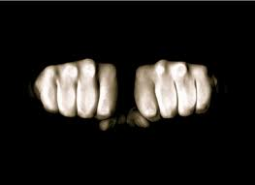
Progressive Muscle Relaxation

Slide 78
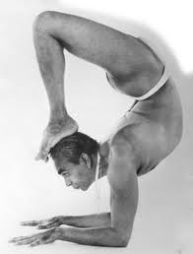
Breathing Basics
”The mind controls the body, but the breath controls the mind.“
B.K.S. Iyengar

Slide 79

Breathing Basics
”Teaching breathing exercises to your client is like teaching a teenager when to accelerate and when to brake the car.“
Amy Weintraub

Slide 80

Practicing Awareness of Breath

Slide 81
Breathing Basics
Diaphragmatic breathing
Complete breathing
Ujjayi breathing

Slide 82
Breathing Basics
Dr. Andrew Weil (2010)
http://www.drweil.com/drw/u/ART00521/three-breathing-exercises.html
A-B-C of Yoga (2010)
http://www.abc-of-yoga.com/pranayama/

Slide 83

Breathing Basics
Clients who are easily activated may not feel comfortable closing their eyes during breath work. Reiterate that it is not necessary to close the eyes during these exercises.
Start slowly…if a client is not used to breathing deliberately, don’t overwhelm him. Starting with a few simple breaths, and encouraging repetition as a homework assignment, is fine.
If a client has a history of respiratory difficulties, make sure to obtain a release to speak with her medical provider before proceeding.

Slide 84
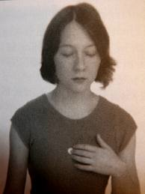
Pressure Points
Sea of Tranquility
Letting Go/Butterfly Hug
Gates of Consciousness
Third Eye (and variations)
Karate Chop

Slide 85

Yoga
Dr. Bessel Van Der Kolk is a leading research proponent of using yoga as a primary and adjunctive treatment for PTSD
Yoga, if integrated safely and appropriately, is at very least, an ideal coping skill technique in traumatized individuals
Many high profile addiction treatment centers throughout the world offer yoga

Slide 86

Yoga
Recommendation:

Slide 87
Guided Imagery
The purpose of guided imagery as a stabilization coping exercise is to provide the client with a safe, healthy mental escape that he/she can access when needed
If you do not feel comfortable to develop your own guided imageries, there are many free scripts available online, use with caution to context
Avoid “place” guided imageries until you see how a client is going to respond

Slide 88

Variations Other Than Imagery
Sound
Smell
Touch/Tactile
Taste

Slide 89

Mindfulness
Mindfulness means paying attention in a particular way: on purpose, in the presence of the moment, and non-judgmentally.
-Jon Kabat-Zinn (2011)

Slide 90

Acceptance
acceptance as Buddhist mindfulness principle
12-step recovery (Alcoholics Anonymous, 2001; p. 417)
”radical acceptance” (from dialectical behavioral therapy)
Acceptance and Commitment Therapy (ACT)

Slide 91

Empowerment
Encourage that change is possible, no matter how chronic the relapser… be sincere about it (Marich, 2010).
Foster identification as a survivor, not a victim (Hantman & Solomon, 2007)
Promote choice at every junction
(Marich, 2014)
Notes:
NOTE TO SELF….Address this in terms of the shame piece ☺

Slide 92
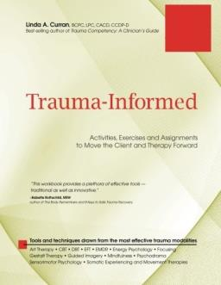
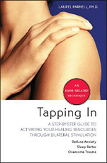
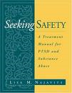
Recommendations

Slide 93
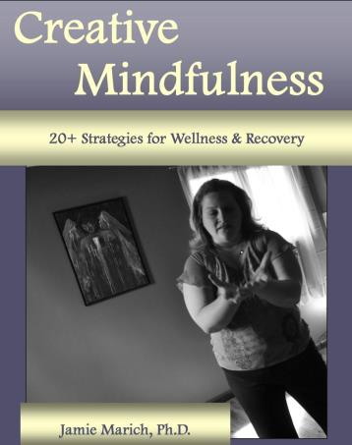
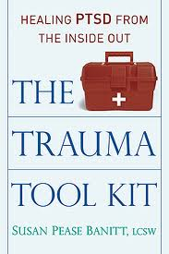
Recommendations

Slide 94
BREAK TIME

Slide 95
Factors to Consider Before Going Farther
Does the client have a reasonable amount of coping skills to access?
Is there a sufficient amount of positive material in the client’s life?
What is the nature of the living situation (safety)?
Have you looked at the picture with drug/alcohol use, including psychotropic medication?
Is the client willing (and ready) to look at past issues?
Have you assessed for secondary gains and other related issues?
Have you considered number of sessions available?

Slide 96
Review: (Re)Processing
I am not good enough →
I am good enough

Slide 97
➔

Slide 98
So, What Works for Trauma Processing?
A meta-analysis examining all studies on bona fide treatments for PTSD (e.g., desensitization, hypnotherapy, PD, TTP, EMDR, Stress Inoculation, Exposure, Cognitive, CBT, Present Centered, Prolonged exposure, TFT, Imaginal exposure) conducted between 1989-2007 found no statistical significance amongst the treatments (Benish, Impel, & Wampold, 2008).
The only factor leading to any statistically significant impact was therapist allegiance.

Slide 99
Bisson & Andrew (2007)
Meta-analysis of over 30 studies about PTSD over an 8 year period (1996-2004)
Past-oriented PTSD treatments were far superior to coping skill only PTSD treatments
Past-oriented or trauma-oriented treatments can include past-oriented cognitive behavioral therapy, exposure therapy, hypnosis, or EMDR

Slide 100
The Common Factors
Client and extratherapeutic factors
Models and techniques that work to engage and inspire the participants
The therapeutic relationship/alliance
Therapist factors
Source: Duncan, B.L., Miller, S.D., Wampold, B.E., Hubble, M.E. (2009). The heart and soul of change: Delivering what works in psychotherapy. (2nd ed.) Washington, D.C.: American Psychological Association.

Slide 101
This Leaves You with the Following Options:
Mindfulness Based Cognitive Therapy
Narrative Therapy
Neurofeedback
Neurolinguistic Programming
Neuroemotional Technique ®
Play Therapy
Psychodrama/Drama Therapy
Psychodynamic therapy
Sensorimotor Psychology ®
Somatic Experiencing ®
Stress Innoculation
Systematic Desensitization
Trauma-Focused Cognitive Behavioral Therapy
Yoga Therapy
Accelerated Experiential Dynamic Psychotherapy
Acceptance and Commitment Therapy
Art Therapy
Dialectical Behavioral Therapy
The Developmental Needs Meeting Strategy
Emotional Freedom Technique
EMDR
Energy Psychology
Equine-Assisted/Pet Therapy
Exposure Therapy
Focusing
Gestalt Therapy
Hakomi
Hypnosis & Hypnotherapy
Internal Family Systems Therapy
Interpersonal Neurobiology
Life Span Integration Therapy

Slide 102

Where Am I at With Trauma?

Slide 103
Why it Matters
The literature in general traumatic stress studies suggests that the therapeutic alliance between client and clinician is an important mechanism in facilitating meaningful change for clients with complex PTSD (Fosha, 2000; Fosha & Slowiaczek, 1997; Courtois & Pearlman, 2005; Keller, et al., 2010)

Slide 104
Qualities of a Good Trauma Therapist
Parnell (2007)
Good clinical skills
Ability to develop rapport with clients
Comfort with trauma and intense affect
Well-grounded
Spacious
Attuned to clients

Slide 105
Qualities of a Good EMDR/Trauma Therapist
Marich (2010)
caring
trustworthy
intuitive
natural good common sense
connected smart
comfortable with trauma work consoling
skilled validating
accommodating gentle
magical nurturing
wonderful facilitating

Slide 106
Beutler, et al. (2005)
On the Connection Between Therapist Traits & Client Outcomes
Effective therapists are interested in people as individuals
Have insight into their own personality characteristics
Have concern for others
Intelligent
Sensitive to the complexities of human motivation
Tolerant
Able to establish warm and effective relationships with others

Slide 107
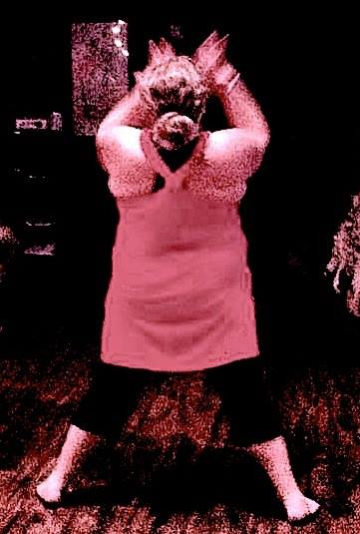
Charman (2005)
mindful
not having an agenda
having concern for others
intelligent
flexible in personality
intuitive
self-aware
knows own issues
able to take care of self
open
patient
creative

Slide 108
Intense Affect & Abreaction
“The therapeutic process of bringing forgotten or inhibited material (i.e., experiences, memories) from the unconscious into consciousness, with concurrent emotional release and discharge of tension and anxiety.”
APA Dictionary of Psychology; VandenBos (2007)

Slide 109
For Continued Development
How many of the qualities on these lists do I possess?
How do I handle intense affect and abreaction?
What are my personal barriers with grief and trauma?
What factors may inhibit me from being effective with someone struggling with trauma and/or grief?
When is the best time to use collaborative referrals?

Slide 110
www.traumatwelve.com/powerpoint

Slide 111

To contact today’s presenter:
Jamie Marich, Ph.D., LPCC-S, LICDC-CS
Mindful Ohio
jamie@jamiemarich.com
www.mindfulohio.com
www.jamiemarich.com
www.drjamiemarich.com
www.dancingmindfulness.com
www.TraumaTwelve.com
Phone: 330-881-2944

