Slide 1

EMDR & Mindfulness
Interventions for
Anxiety, Depression, Panic, Trauma, and Other Disorders
Jamie Marich, Ph.D., LPCC-S, LICDC-CS
Founder & Director, Mindful Ohio
EMDRIA-Approved Consultant

Slide 2
About Your Presenter
Licensed Supervising Professional Clinical Counselor (MH)
Licensed Independent Chemical Dependency Counselor
Member of the American Academy of Experts on Traumatic Stress
Author, EMDR Made Simple & Trauma and the Twelve Steps
Twelve years of experience working in social services and counseling; includes three years of experience in civilian humanitarian aid in Bosnia-Hercegovina
Specialist in addictions, trauma, abuse, dissociative disorders, performance enhancement, grief/loss, and pastoral counseling
Trained in several specialty interventions for trauma
Creator of the Dancing Mindfulness practice

Slide 3

What led you to this conference?

Slide 4
Objectives
Describe mindfulness and implement specific mindfulness practices to use with a variety of disorders including: PTSD, phobias, panic disorder, generalized anxiety and more
Experience the importance of stabilization in the 3-Stage Treatment Triangle
Explain the neurobiology of trauma and understand how to use the brain’s neuroplasticity to help clients re-wire their brains towards healing
Describe EMDR and how it may be use with children and adults, with “Big T” and “little T” trauma
Understand how EMDR and Mindfulness can complement one another for maximum utilization in your practice

Slide 5
Audience
If you are not EMDR-trained this course will orient you to mindfulness and its clinical applications, and will help orient you to EMDR by highlighting its similarities to mindfulness
If you are an EMDR-trained therapist, this course will help you to enhance you understanding of the approach, especially by discussing what “go what that” means in mindfulness work and giving you new ideas for stabilization/preparation

Slide 6
Mindfulness
Paying attention in a particular way: on purpose, in the presence of the moment, and non-judgmentally (Kabat-Zinn, 1994/2005)
Paying attention as if your life depended on it (Kabat-Zinn, 2011)
Comes from the Sanskrit word meaning “awareness,” specifically, “coming back to awareness”

Slide 7
Mindfulness
Please consult your manual for the most recent meta-analytic studies supporting the use of mindfulness with clinical presentations
Web-based resources to look up further information on your specific areas of interest with mindfulness are also in the manual

Slide 8

Seven Primary Attitudes
Non-judging
Patience
Beginner’s Mind
Trust
Non-striving
Acceptance
Letting go

Slide 9
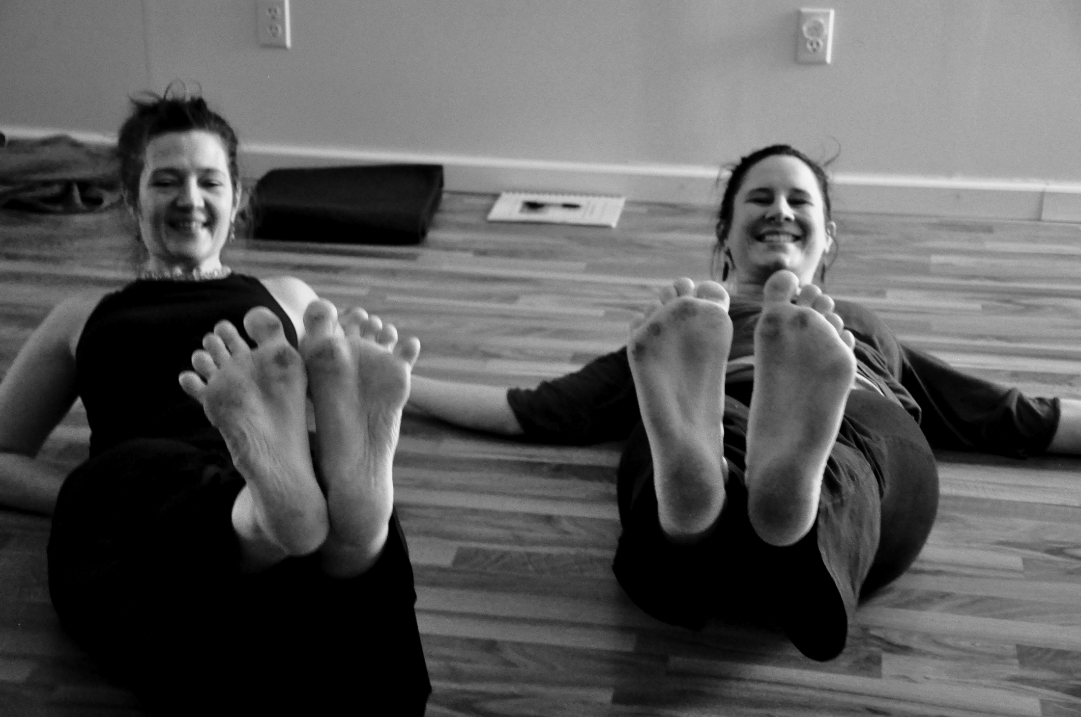
Other Potential Attitudes
Friendliness
Gratitude
Gentleness
Curiosity
Non-attachment
Non-reactivity
Happiness
Creativity
Attunement
Persistence
Confidence
Willingness

Slide 10

An Introduction to Classic Mindfulness Practices

Slide 11

Skill 1:
Practicing Awareness

Slide 12


Slide 13

Skill 2:
Belly Breathing

Slide 14

Skill 3:
Body Cuing

Slide 15
The Role of Somatic Awareness in Reprocessing Therapies

Slide 16

Skill 4:
Light Stream Imagery + Body Scan

Slide 17
The Role of Light Stream & Body Scan in EMDR

Slide 18
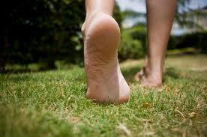
Skill 5:
Walking Meditation

Slide 19
Walking Meditation:
The Original “BLS”

Slide 20
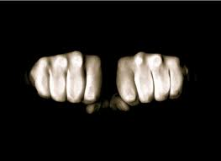
Skill 6:
Clench & Release

Slide 21
Clench & Release:
Bilateral Variations

Slide 22
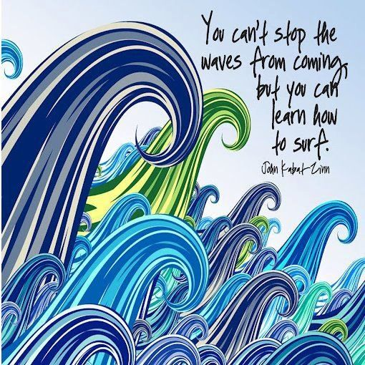

Slide 23
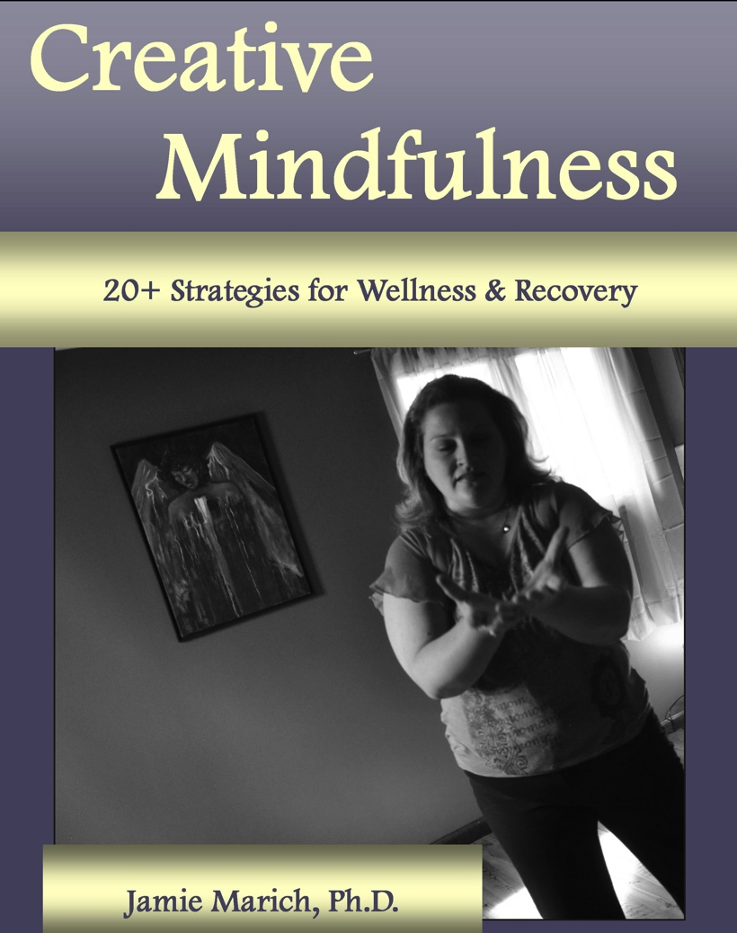
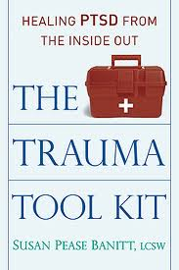

Recommendations

Slide 24
BREAK TIME

Slide 25
Trauma

Slide 26

Large T Trauma vs. small t trauma

Slide 27
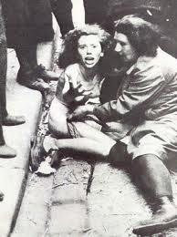
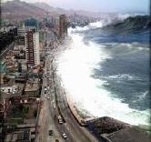

Trauma: Large-T or “Big” T
Examples include: combat, natural disasters, sexual abuse, assault, other violent crimes
“Big T” trauma is what the psychological community references in speaking about the PTSD diagnosis.

Slide 28
DSM-IV-TR Nutshell Definition of PTSD
(Post-Traumatic Stress Disorder )
(APA, 2000)
Actual or perceived threat of injury or death- response of hopelessness or horror (Criterion A)
Re-experiencing of the trauma
Avoidance of stimuli associated with the trauma
Heightened arousal symptoms
Duration of symptoms longer than 1 month
Functional impairment due to disturbances

Slide 29
DSM-5 ® Nutshell Definition of PTSD
(Post-Traumatic Stress Disorder )
(American Psychiatric Association, 2013)
Exposure to actual or threatened a) death, b) serious injury, or c) sexual violation: direct experiencing, witnessing (Criterion A)
Intrusion symptoms (Criterion B)
Avoidance of stimuli associated with the trauma (Criterion C)
Cognitions and Mood: negative alterations (Criterion D)
Arousal and reactivity symptoms (Criterion E)
Duration of symptoms longer than 1 month
Functional impairment due to disturbances

Slide 30

Trauma: small-t
Not necessarily life threatening, but definitely life-altering
Examples include grief/loss, divorce, verbal abuse/bullying, and just about everything else…
The trauma itself is not “the problem,” it’s whether or not the trauma has been able to heal/process adaptively that leads to problems
If it was traumatic to the person, then it’s traumatic.
According to the adaptive information processing model, “little t” trauma can be just as valid and as clinically significant as “Big T” trauma.

Slide 31
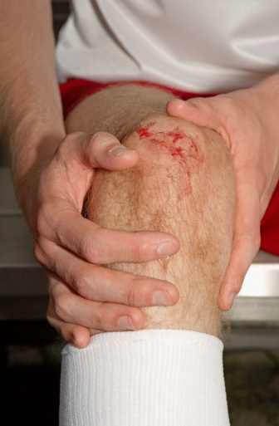
Etymological Origin
Trauma comes from the Greek word meaning wound
What do we know about physical wounds and how they heal?

Slide 32
Trauma and the Adaptive Information Processing Model (Part I: Highlights)
Memory networks are the basis of perception, attitude and behavior…they inform the present.
The information processing system moves disturbance to an adaptive resolution…the events that don’t get processed through adaptively give us problems later in life.
Disruption of the information processing system causes information (e.g., seen, heard, felt) to be unprocessed and inappropriately stored as it was perceived.
(SOURCE: Shapiro, 2001; Shapiro & Solomon, 2008)

Slide 33

Unprocessed and inappropriately stored as it was perceived =
STUCK material that causes disturbance

Slide 34

How can something then get “unstuck”?

Slide 35
Trauma and the Adaptive Information Processing Model (Part II: Highlights)
Accessing information allows link between consciousness and where information is stored
The unprocessed components/manifestations of memory (image, thought, sound, emotions, physical sensations, beliefs) change/transmute during processing to an adaptive resolution
Information processing transmutes through all accessed channels
(SOURCE: Shapiro, 2001; Shapiro & Solomon, 2008)

Slide 36

Trauma and the Adaptive Information Processing Model (Part III: Highlights)
Byproducts of reprocessing include desensitization (lessening of disturbance), insights, changes in physical and emotional responses
(SOURCE: Shapiro, 2001; Shapiro & Solomon, 2008)

Slide 37

A Client’s Perspective: from Marich (2010)
Fadalia (pseudonym), a recovering heroin addict with complex trauma reflected on where she was at before receiving the integrated treatment that led to her longest sobriety to date (3 years):
“Before [treatment], my feelings, thoughts and experiences were all tangled like a ball of yarn. I needed something to untangle them.”

Slide 38

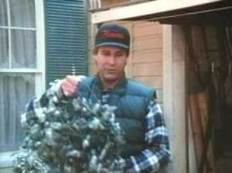
➔

Slide 39


Slide 40
An EMDR Client’s Perspective:
Lily Burana (2009)
“PTSD means, in ‘talking over beer’ terms, that you’ve got some crossed wires in your brain due to the traumatic event. The overload of stress makes your panic button touchier than most people’s, so certain things trigger a stress reaction- or more candidly- an over-reaction. Sometimes, the panic button gets stuck altogether and you’re in a state of constant alert, buzzing and twitchy and aggressive.”

Slide 41
An EMDR Client’s Perspective:
Lily Burana (2009)
“Your amygdala- the instinctive flight, fight, or freeze part of your brain- reacts to a trigger before your rational mind can deter it. You can tell yourself, ‘it’s okay,’ but your wily brain is already ten steps ahead of the game, registering danger and sounding the alarm. So you might say once again, in a calm, reasoned cognitive-behavioral-therapy kind of way, ‘Brain, it’s okay…’

Slide 42
An EMDR Client’s Perspective:
Lily Burana (2009)
“But your brain yells back, ‘Bullshit kid, how dumb do you think I am? I’m not falling for that one again.’ By then, you’re hiding in the closet, hiding in a bottle, and/or hiding from life, crying, raging, or ignoring the phone and watching the counter on the answering machine go up, up, up, and up. You can’t relax, and you can’t concentrate because the demons are still pulling at your strings.”

Slide 43
An EMDR Client’s Perspective:
Lily Burana (2009)
“The long-range result is that the peace of mind you deserve in the present is held hostage by the terror of your past.”

Slide 44
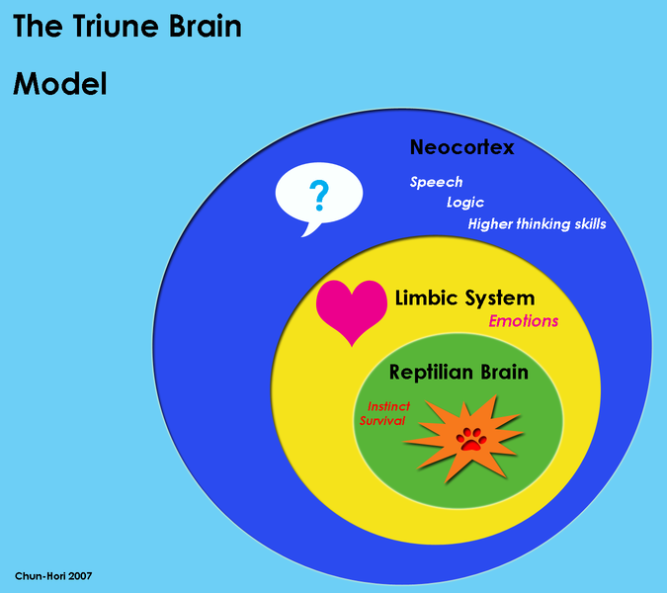

Slide 45
General Consensus Model of Trauma Treatment
PHASE I: Stabilization
PHASE II: Processing of Trauma
PHASE III: Reintegration

Slide 46
General Consensus Model of Trauma Treatment
ISTSS 2012 Expert Panel Recommendations state that, regardless of specific modality, this general framework should be followed in treating trauma

Slide 47
EMDR: Changing the Way We Thinking About Reprocessing
Eye Movement Desensitization and Reprocessing
This name is actually a clinical misnomer, because it can be used with several forms of bilateral stimulation (BLS), not just eye movements
EMDR, according to founder Francine Shapiro, is more of a historical name, indicative of the therapy in its original form

Slide 48

Shapiro compares it to Coca-Cola ©.
The “cocaine” was taken out in 1908, yet the name remained.

Slide 49

EMDR: The Story
Dr. Shapiro: A cancer survivor with interest in mind-body medicine, including mindfulness meditation
Founded serendipitously by California psychologist Francine Shapiro in 1987 during a “walk in the park”
First study of her systematized protocol, EMD, published in 1989
Switch to EMDR also made in 1989
Other forms of BLS discovered and implemented in 1990
EMDR is one of the most researched treatments for PTSD
Dr. Shapiro currently considers EMDR to be a distinct approach to psychotherapy

Slide 50
EMDR: General Comments
Alan Moskovitz, M.D. (2001), a leading expert in treating borderline personality disorder has described EMDR as:
“An artful blend of several therapeutic techniques, including exposure therapy, cognitive therapy, and even an abbreviated form of the free association of psychoanalytic psychotherapy.”

Slide 51
EMDR is currently approved as a highly efficacious treatment for trauma by the:
American Psychiatric Association
American Psychological Association
Veterans Administration and the Department of the Defense
International Society of Traumatic Stress Studies
countless other clinical bodies…

Slide 52
Unprocessed and inappropriately stored as it was perceived = STUCK material
The eye movements or other bilateral stimulation used in EMDR are the primary mechanism for moving this stuck material through to a more adaptive place (i.e., to the pre-frontal cortex).

Slide 53
So what is bilateral stimulation?

Slide 54


Primary Forms of Bilateral Stimulation Used in EMDR
Eye movements (the original)
Audio tones
“Taps”/Tactile stimulation
- machine-generated or touch
- “Patty cake”/Butterfly Hug
- walking, other creative measures

Slide 55

Similarities to Bilateral Forms of Native American Healing Ritual

Slide 56
Bilateral Stimulation
Slow, short sets are used for client stabilization…similar to “driving slowly” through a pleasant scene
Longer, faster sets are used for trauma processing and beyond…similar to “driving quickly” through a scary area

Slide 57

The EMDR Approach
EMDR does not bring up memories just for the sake of bringing them up.
The purpose of EMDR is to help people live a more adaptive life.

Slide 58
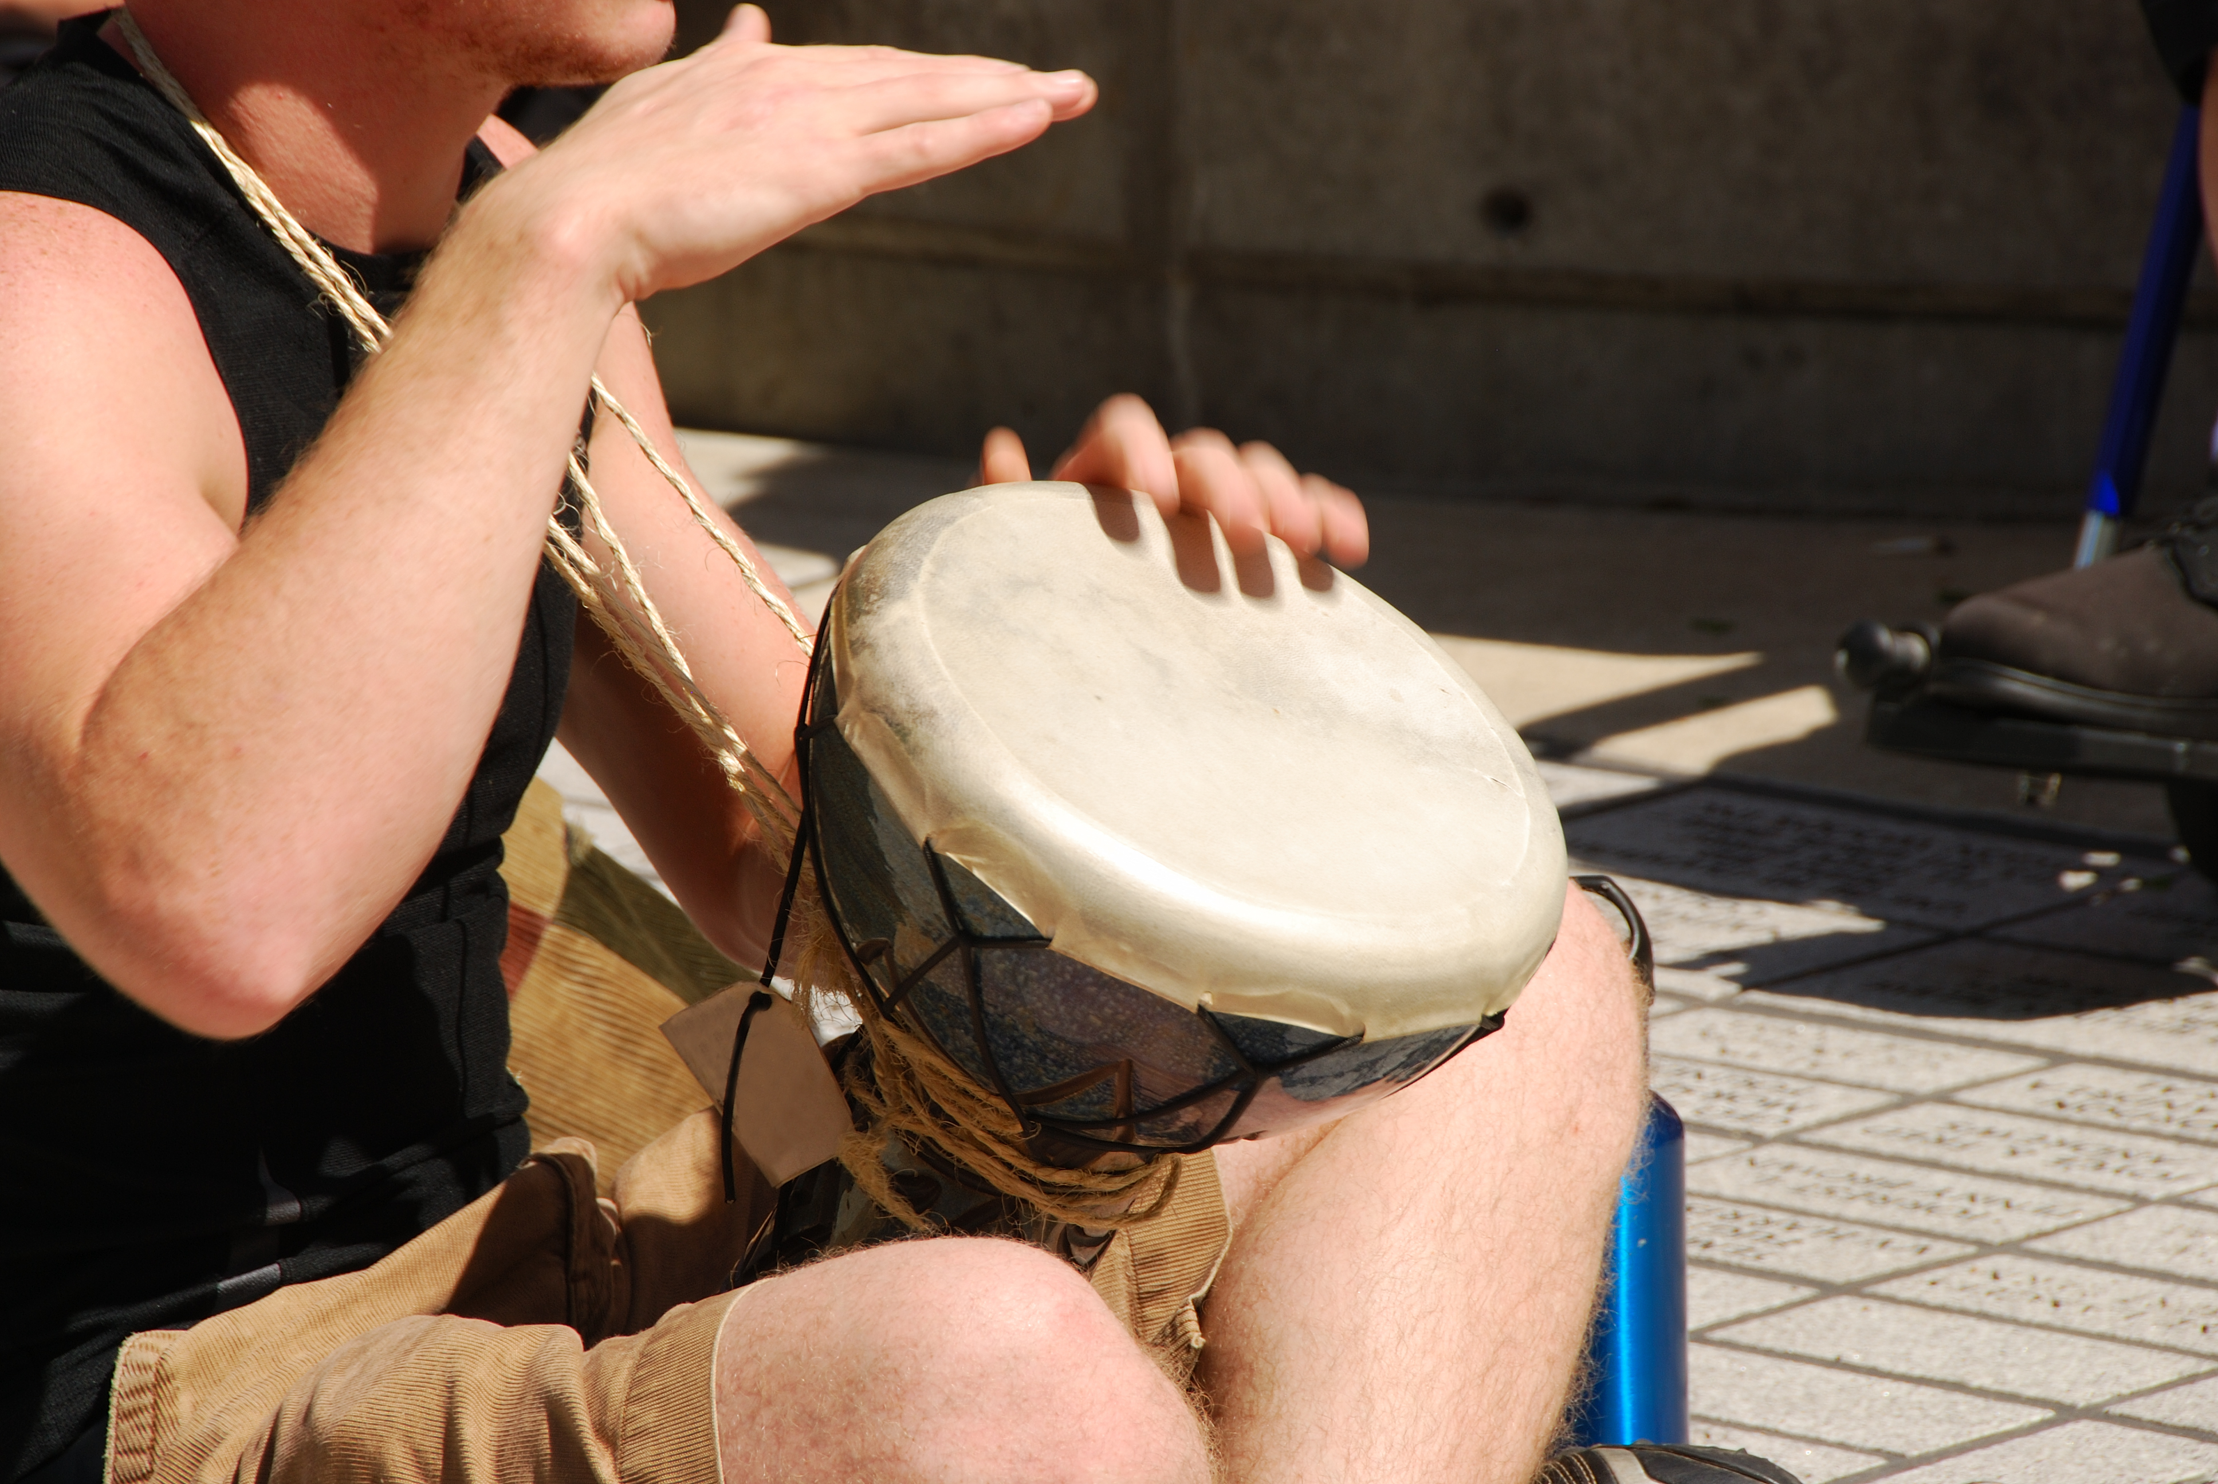
Skill 7: Modified Drum Circle

Slide 59

Discussion
For those of you already trained in EMDR, or for those of you who have experienced it as clients, what role did the drumming play in enhancing your understanding of bilateral stimulation?

Slide 60
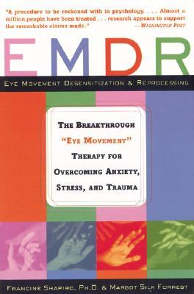
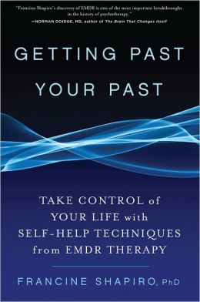
Recommendations

Slide 61
Please Return by 1:00pm

Slide 62

Skill 8: Butterfly Hug or
Monkey Tap (for Stabilization)

Slide 63
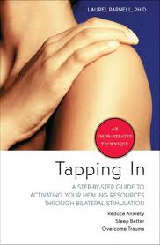
“Resource Tapping” & Mindfulness

Slide 64
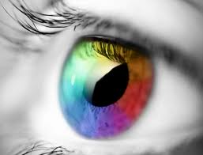
EMDR Demonstration

Slide 65
Discussion
For those of you already trained in EMDR, what did you notice about the role that mindfulness played in Dr. Marich’s demonstration with the volunteer, using standard protocol?
For those of you not trained in EMDR, what are your reactions? What elements of mindfulness were present?

Slide 66
“Go With That”
A classic phrase used in EMDR training, deriving from mindfulness meditation, specifically Vipassana meditation (a form of mindfulness meditation)
What role did “go with that,” or its variations, play in this demonstration?
What does “go with that” mean to you?

Slide 67
Vipassana Meditation
A form of meditation typically grouped with the mindfulness approach
Mindfulness of breathing a major facet
Etymology: “clear seeing” or “before the eyes”
Aim is to promote introspection, observation of bodily sensations, analysis through sitting with the lived experience
Many see it as “EMDR without the eye movements”

Slide 68
Eight Phases of EMDR
(Shapiro, 2001)
1.) Client history (includes treatment planning)
2.) Client preparation
3.) Assessment (of the target memories)
4.) Desensitization
5.) Installation
6.) Body scan
7.) Closure
8.) Re-evaluation

Slide 69
BREAK TIME

Slide 70

Skill: Ujjayi Breathing (Ocean Breathing)

Slide 72
Mindfulness & The Brain
Plays a key role in activating the pre-frontal cortex and promoting a greater sense of concentration (Graham, 2013)
Mindfulness can calm a client’s inner experience and promote greater introspection (Porges, 2011)
Structured mindfulness practice can cause positive structural changes in the brain related to learning and memory (hippocampus) and can cause a thinning in the amgydala, lessening the charge of fear-based responses (Kabat-Zinn, 2011)

Slide 73
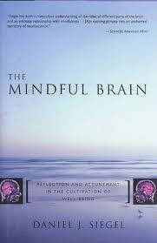
Mindfulness & The Brain

Slide 74
Neurological Implications for Combining Mindfulness Practice with EMDR & Other Reprocessing Therapies
Simple mindfulness practices are ideal for preparation work; not only are they excellent coping skills, they get the brain ready for deeper work
The attitudes of mindfulness, if being actively cultivated, put the brain in a better position to process
Simple mindfulness strategies (whether bilateral or not) are ideal for closing down a session or for clients to access on their own in between sessions for affect regulation

Slide 75
Research Articles on
EMDR & Mindfulness Combination
Corrigan (2002)
Herbert (2002)
Sun, Wu, & Chiu (2004)
Tzan-Fu & Nien-Mu (2006)
Lehrer, Woolfolk, & Sime (2007)
Van den Hout, et al. (2011)

Slide 76
The Four Faces of EMDR (Marich, 2011)
Face 1: Strict adherence to Shapiro protocols and writings/EMDRIA definitions
Face 2: Flexible EMDR (e.g., writings of Laurel Parnell)
Face 3: EMDR as technique, not approach
Face 4: EMDR-Informed interventions (e.g., brainspotting, DNMS, Dancing Mindfulness)

Slide 77
Connections
Mindfulness shows up in any face of EMDR in the modern era
Focusing on more of the mindfulness elements of EMDR can lead to improved outcomes within EMDR
Emphasizing the mindfulness elements of EMDR can make it easier to teach and to understand the approach to clinicians
Mindfulness skills can be easily taught by clinicians to their clients, even though it will take some discipline to implement them for maximum effectiveness
EMDR may be a solution for clients to work through their mental blocks to more fully practicing mindfulness and internalizing the benefit of its attitudes in their lives
Mindfulness work and EMDR are a natural combination

Slide 78

Skill 9: Sufi Grinder &
Simple Bilateral Movements

Slide 79

Options for Further Training:
EMDR & Other Reprocessing Therapies

Slide 80
Discussion
(Grouped by EMDR-Trained & General Clinicians)
For those of you already trained in EMDR, what did you learn today about the role of mindfulness in EMDR? How can you take what you learned today and apply?
For those of you not trained in EMDR, what are your reactions to the content covered today?

Slide 81

Skill 10: Energetic Massage

Slide 82

To contact today’s presenter:
Jamie Marich, Ph.D., LPCC-S, LICDC-CS
Mindful Ohio
jamie@jamiemarich.com
www.mindfulohio.com
www.jamiemarich.com
www.drjamiemarich.com
www.dancingmindfulness.com
www.TraumaTwelve.com
Phone: 330-881-2944

