Slide 1
A Person-Centered Approach to Addiction Treatment
Jamie Marich, Ph.D., LPCC-S, LICDC-CS
Director, Mindful Ohio

Slide 2
About Today’s Presenter
Licensed Supervising Professional Clinical Counselor (MH)
Licensed Independent Chemical Dependency Counselor
Member of the American Academy of Experts on Traumatic Stress
Fourteen years of experience working in social services and counseling; includes three years of experience in civilian humanitarian aid in Bosnia-Hercegovina
Specialist in addictions, trauma, abuse, dissociative disorders, performance enhancement, grief/loss, and pastoral counseling
Trained in several specialty interventions for trauma & addiction
Author of 3 books on trauma, including Trauma & The Twelve Steps
Creator of the Dancing Mindfulness practice

Slide 3

What led you to today’s workshop?

Slide 4
Learning Objectives
Describe the disease model of addiction and at least three alternative approaches to communicating addiction and implications for treatment
Describe the person-centered approach to psychotherapy and explain how it connects to motivational interviewing principles
Explain the new updates to the DSM-5® on disorders that fall under the umbrella of addiction
Assess for the presence of addiction and its impact on quality of life in an individual using at least three different methods
Develop individualized, addiction-specific intervention and treatment plans
Implement at least five treatment techniques into treatment planning
Explore personal, professional, and societal implications of treating addiction and be able to discuss the importance of offering such treatment solutions

Slide 5
Addiction
What is addiction?
How would you define addiction, based on your clinical and/or personal experiences?

Slide 6

The Word Nerd Says…
Addiction
-Derives from the Latin, addictus, which means to be assigned or surrendered to something
-Another Latin derivation is addicere, which to be fixated on or favoring something

Slide 7

The Addiction Cycle
(Carnes, 1992)
1.) preoccupation
2.) ritualization
3.) the act (e.g., sex, drug use)
4.) despair/depression

Slide 8
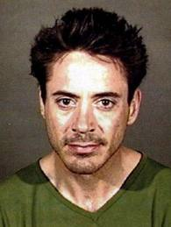
From Robert Downey, Jr. (2008)
“Anyone who can’t go five minutes without a cigarette, or can’t stop drinking or is strung out on drugs, knows that after a while there develops an attachment to the ritual of using it that has little to do with your original motive. The original impetus was to feel its effect, and the effect seemed positive at the time. But if years down the road you are still saying, ‘Baby, I do it because it makes me happy,’ you don’t really mean it.”

Slide 9

A Point to Consider
Every form of addiction is bad, no matter whether the narcotic be alcohol or morphine or idealism.
-Dr. Carl Jung

Slide 10
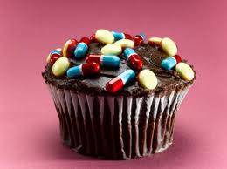
A Point to Consider
Whether you sniff it smoke it eat it or shove it up your ass the result is the same: addiction.
-William S. Borroughs (Author)

Slide 11

Dr. Marich’s
Working Definition
Addiction is continuing to do something (e.g., drink alcohol, smoke cigarettes, gamble, engage in sexual activity), even when the activity causes repeated pain and consequences.
SOURCE: GWC, Inc. (1993), Human Addiction

Slide 12
These consequences can be…
Physical/Biological
Psychological/Emotional
Social/Occupational
Spiritual/Existential
In people with addictive disorders, we typically see a combination of these four areas being affected.

Slide 13
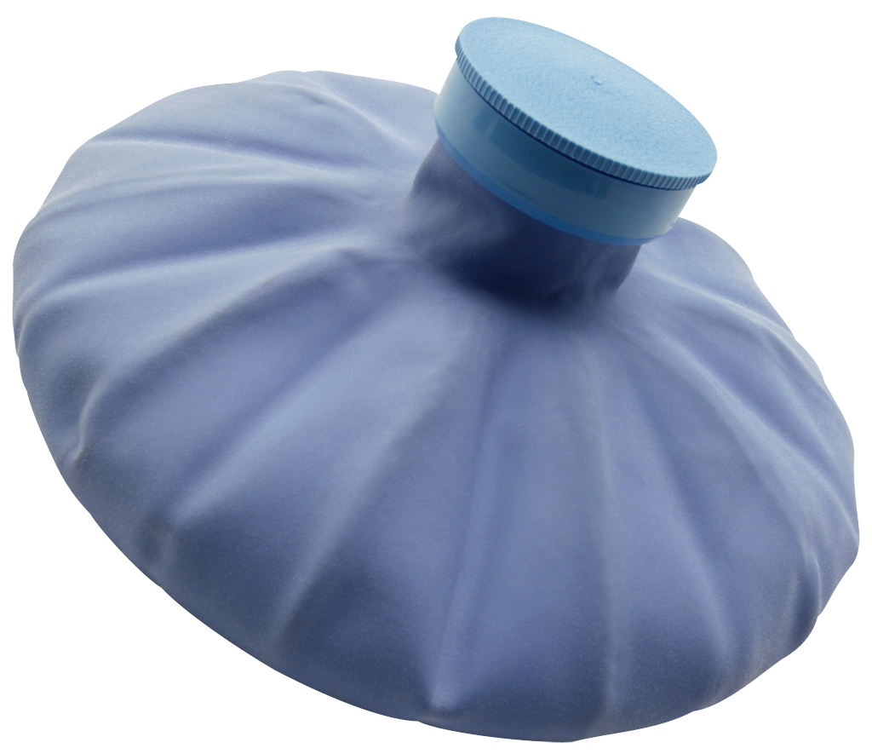
Models of Addiction
Disease concept of addiction first published in Alcoholics Anonymous (1939)
Addiction has been classified as a disease by the American Medical Association since 1952.
So what exactly does disease mean???

Slide 14
From Dr. Kevin McCauley (2009):
Organ→ Defect (Cause) → Symptoms
Femur→ Fracture (e.g., skiing) → Pain
Pancreas → No Insulin → Blindness, Numbness, Wounds

Slide 15
From Dr. Kevin McCauley (2009):
___________ → __________ → _____________
___________ → __________ → _____________
* Addiction (McCauley): defect in the brain’s ability to perceive, process, and act upon pleasurable/painful experiences

Slide 16
From Dr. Kevin McCauley (2009):
___________ → __________ → _____________
Midbrain → Various * → Biopsychosocial Consequences
* Addiction (McCauley): defect in the brain’s ability to perceive, process, and act upon pleasurable/painful experiences

Slide 17
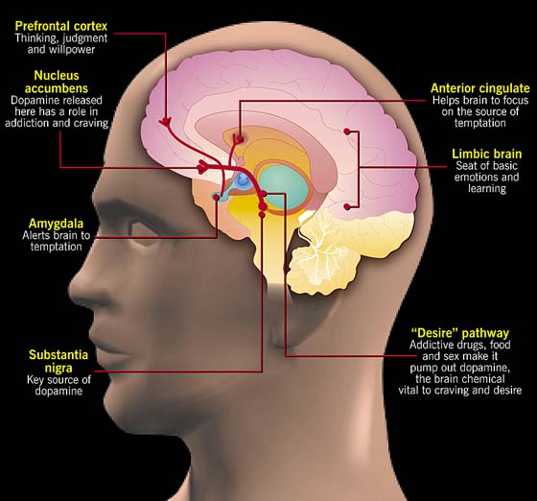

Slide 18
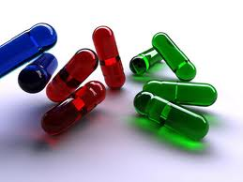

From Dr. Kevin McCauley (2009):
For a non‐addict, drug=drug
For an addict, drug=survival

Slide 19

From Dr. Pat Carnes:
Addiction refers to the entire pattern of maladaptive behaviors, cognitions, belief systems, consequences and affects on others, not just the behavior as in compulsivity
SOURCE: Carnes, as cited in Hagedorn & Junke, 2005

Slide 20

Models of Addiction
Although there is widespread-acceptance and research support for the disease model in the psychiatric and psychotherapeutic professions, many alternate models exist:
-pleasure model/habit model (behavioral)
-moral model
-genetic model
-cultural model
-allostatic model

Slide 21

Models of Addiction
Rigid acceptance of the disease model, or either of these alternative models is neither optimally trauma-sensitive nor ultimately effective in providing individualized care.

Slide 22
What makes something a drug of choice for someone?

Slide 23

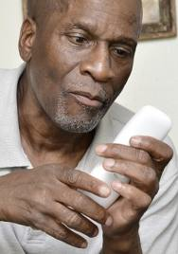
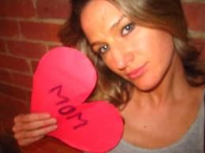
Discovering the Story
What was the first memory of pain relief?
What was the most potent memory of pain relief?
What was the most recent memory of pain relief?

Slide 24

What Have We Learned From ‘Crime Drama’?
Means
Motive
Opportunity

Slide 25
Case Study: J.R.
Born to a poor farming family in the rural Midwest just before World War II
Witnessed the death of his older brother, the favorite child in the family, in a fatal farming accident
Father’s verbal, emotional and physical, abuse intensified after the death of his brother
Father was likely an alcoholic; constantly reminded J.R. that he should have died, not his brother

Slide 26

Case Study: J.R.
J.R. had a good relationship with his mother, even though she showed multiple codependent tendencies
J.R.’s mother fostered his love of music, mostly spiritual hymns, which became J.R.’s only real coping skill

Slide 27

Case Study: J.R.
Served in the Korean War, although his father minimized his service because he never went into combat
Despite a rocky first marriage, J.R. soon became very successful at following his dream of a career in music, despite the protests of his father

Slide 28
Case Study: J.R.
J.R. had always been a recreational drinker, but the pressures of his new career, coupled with a dearth of other coping skills, caused his alcohol and later drug use to escalate. Also developed a problem with several behavioral addictions, namely sex
Arrested several times for drug-related charges as his addiction progressed

Slide 29
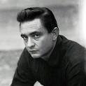
Your thoughts???

Slide 30
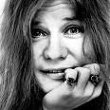
February 20, 1968
Dear Mother—
From all indications I’m going to become rich and famous. All sorts of magazines are asking to do articles and pictures featuring me. I’m going to do every one. Wow, I’m so lucky- I just fumbled around being a mixed up kid and then I fell into this. And finally it looks like everything is going to work out for me.
I’m awfully sorry to be such a disappointment to you. I understand your fears at my coming here and must admit I share them, but I really do think there’s an awfully good chance I won’t blow it this time. There’s really nothing more I can say now. Guess I’ll write more when I have more news, until then, address all criticism to the above address. And please believe me that you can’t possibly want for me to be a winner more than I do.
Love, Janis
Source: Joplin, L. (2004)

Slide 31

“The Whitney I knew, despite her success and worldwide fame, still wondered: Am I good enough? Am I pretty enough? Will they like me?
It was the burden that made her great . . .
So off you go, Whitney, off you go . . . escorted by an army of angels to your Heavenly Father. And when you sing before Him, don’t you worry — you’ll be good enough.”
-from Kevin’s Costner’s eulogy

Slide 32

“I have absolutely no pleasure in the stimulants in which I sometimes so madly indulge. It has not been in the pursuit of pleasure that I have periled life and reputation and reason. It has been the desperate attempt to escape from torturing memories, from a sense of insupportable loneliness and a dread of some strange impending doom.”
-Edgar Allen Poe

Slide 33

Film/Book Recommendation:
Love Sick (2008)
Based on the book by Sue William Silverman
Full film access available through:
www.suewilliamsilverman.com

Slide 34

Book Recommendation:
Moments of Clarity (2009)
Edited by Christopher Kennedy Lawford

Slide 35

Book Recommendation:
The Secret Lives of Hoarders (2011)
by Matt Paxton

Slide 36

Book Recommendation:
She Bets Her Life: A True Story of Gambling Addiction (2011)
by Mary Sojourner

Slide 37

Book Recommendation:
Spent: Break The Buying Obsession and Discover Your True Worth(2009)
by Sally Palaian

Slide 38
BREAK TIME

Slide 39

DSM-5
For the latest updates on DSM-5, visit the official website at www.dsm5.org

Slide 40
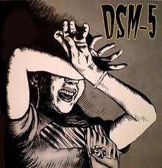
DSM-5®

Slide 41
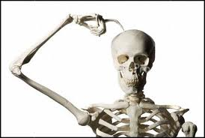
DSM-5®
Substance Use and Addictive Disorders

Slide 42
New/Modified Diagnoses
Classified In This Category
Substance-Induced Psychotic Disorder
Substance-Induced Bipolar Disorder
Substance-Induced Depressive Disorder
Substance-Induced Anxiety Disorder
Substance-Induced Obsessive-Compulsive or Related Disorders
Substance-Induced Sleep-Wake Disorder
Substance-Induced Sexual Dysfunction
Substance-Induced Delirium
Substance-Induced Neurocognitive Disorder

Slide 43
Example Set from DSM-5®
R 00-04 Alcohol-Related Disorders
R 00 Alcohol Use Disorder
R 01 Alcohol Intoxication
R 03 Alcohol Withdrawal
R 04 Alcohol-Induced Disorder Not Elsewhere Classified

Slide 44
___________________ Use Disorder
A. A problematic pattern of alcohol use leading to clinically significant impairment or distress.
B. Two (or more) of the following occurring within a 12-month period:
1. Alcohol is often taken in larger amounts or over a longer period than was intended
2. There is a persistent desire or unsuccessful effort to cut down or control alcohol use
3. A great deal of time is spent in activities necessary to obtain alcohol, use the substance, or recover from its effects
4. Recurrent alcohol use resulting in a failure to fulfill major role obligations at work, school, or home (e.g., repeated absences or poor work performance related to alcohol use; substance-related absences, suspensions, or expulsions from school; neglect of children or household)
5. Continued alcohol use despite having persistent or recurrent social or interpersonal problems caused or exacerbated by the effects of the substance

Slide 45
___________________ Use Disorder
6. Important social, occupational, or recreational activities are given up or reduced because of alcohol use
7. Recurrent alcohol use in situations in which it is physically hazardous (e.g., driving an automobile or operating a machine when impaired by substance use
8. Alcohol use is continued despite knowledge of having a persistent or recurrent physical or psychological problem that is likely to have been caused or exacerbated by the substance
9. Tolerance, as defined by either or both of the following:
a. A need for markedly increased amounts of alcohol to achieve intoxication or desired effect b. Markedly diminished effect with continued use of the same amount of the substance
10. Withdrawal, as manifested by either of the following:
a. The characteristic withdrawal syndrome for alcohol/substance b. The same (or a closely related) substance is taken to relieve or avoid withdrawal symptoms
11. Craving or a strong desire or urge to use the substance

Slide 46
Qualifiers
Early Remission. This specifier is used if, for at least 3 months, but for less than 12 months, the individual does not meet any of the criteria 1-10 for a Substance Use Disorder (i.e. none of the criteria except for Criterion 11, “Craving or a strong desire or urge to use a specific substance”).
Sustained Remission. This specifier is used if none of the criteria 1-10 for a Substance Use Disorder have been met at any time during a period of 12 months or longer (i.e. none of the criteria met except for Criterion 11, “Craving or a strong desire or urge to use a specific substance”).
On Maintenance Therapy. This additional specifier is used if the individual is on a prescribed agonist medication such as methadone or buprenorphine and no criteria for a Substance Use Disorder have been met for that class of medication (except tolerance to, or withdrawal from, the agonist). This category also applies to those being maintained on a partial agonist, an agonist/antagonist or a full antagonist such as oral naltrexone or depot naltrexone.
In a Controlled Environment. This additional specifier is used if the individual is in an environment where access to alcohol and controlled substances is restricted, and no criteria for a Substance Use Disorder have been met. Examples of these environments are closely supervised and substance-free jails, therapeutic communities, and locked hospital units.

Slide 47

Severity Specifiers
The Severity of each Substance Use Disorder is based on:
- 0 criteria or 1 criterion: No diagnosis
- 2-3 criteria: Mild Substance Use Disorder
- 4-5 criteria: Moderate Substance Use Disorder
- 6 or more criteria: Severe Substance Use Disorder

Slide 48
Other Interesting Notes on DSM-5
Gambling disorder moved to this category (out of impulse control disorders)
Added to section III (may be focus of clinical attention, but still in need of more research):
Caffeine Use Disorder
Internet Use Disorder
Neurobehavioral Disorder Associated with Prenatal Alcohol Exposure
Unspecified behavior addiction still under discussion

Slide 49
Trauma and
Substance Use Disorders
-High comorbidity between PTSD and substance use disorders: 27.9% of those with PTSD meet criteria for substance abuse, 34.5% meet criteria for dependence (Kessler et al., 1995; (Peirce, Kindbom, Waesche, Yuscavage, & Brooner, 2008)
-Of patients in substance disorder treatment, 12-34% have PTSD; these numbers can be as high as 33-59% in women (Najavits,2001; 2005). Most gender specialists now agree that the numbers can be just as high in men (Marich, 2014).
- Comorbidity between PTSD and addictions has been established, and untreated PTSD has been identified as a factor in relapse (Miller & Guidry, 2001; Zweben & Yeary, 2006).

Slide 50

WHY?????

Slide 51

Ricci and Clayton (2008)
“Trauma may also disintegrate any sense of a future, thus fostering a propensity for the pursuit of instant gratification” (p. 42).

Slide 52
Watch Out for Masked Grief
Patients often experience maladaptive or problematic psychological symptoms that can be traced back to unresolved grief
Unexplained physical symptoms can also be attributed to a masked grief reaction
Concept attributed to Helene Deutsch, a colleague of Freud’s (see Worden, 2002 for good review/clinical application)

Slide 53

So What is the Role of the Professional?
Identify the presence of addiction and its effects
Assess readiness for change

Slide 54

The Primary Care PTSD Screen
Handout: Primary Care PTSD Screen
This is a helpful resource for all clinicians, especially clinicians who assess. These are four simple questions that may expose a great deal of information about your patient’s experiences with trauma.

Slide 55
The CAGE Screening Tool
Have you ever felt you should cut down your use of drugs?
Have you ever been annoyed when people have commented on your use?
Have you ever felt guilty or badly about your use?
Have you ever used drugs to ease withdrawal symptoms, or to avoid feeling low after using?
Two or more “yes” responses, high probability of alcohol/other substance dependence

Slide 56
The TACE Screening Tool
Tolerance: How many drinks does it take to make you feel high?
Have people annoyed you by criticizing your drinking?
Have you ever felt you ought to cut down on your drinking?
Eye-opener: Have you ever had a drink first thing in the morning to steady your nerves or get rid of a hangover?
Two or more “yes” responses, high probability of alcohol/other substance dependence

Slide 57

For More Information
http://www.niaaa.nih.gov/Publications/

Slide 58

Assessment Tools
Handouts:
The “Greatest Hits” List of Addiction-Specific Beliefs
The “Greatest Hits” List of Problematic Beliefs
Sometimes it is difficult for clients to pinpoint one specific memory in addressing addiction and/or. However, they are more likely to be able to select a pattern of thoughts they have had about themselves after seeing these lists. This is often a good starting point to developing a treatment plan.
*This is an EMDR-related technique, adapted by Dr. Marich for use in broader clinical settings. See the manual for more details.

Slide 59
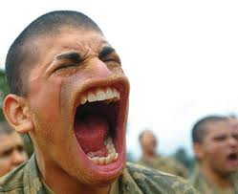
Addressing the “Lie” Factor
As the saying goes…
How do you know when an addict is lying?
When his mouth is moving!

Slide 60

Addressing the “Lie” Factor
An alternate mindset to stay realistic but not get easily jaded or uncompassionate:
Assume you’re not getting the whole story in the first session…that’s why ongoing assessment is vital in working with addictions.

Slide 61
The Rogerian View of Empathy
“Being empathetic reflects an attitude of profound interest in the client’s world of meanings and feelings. The therapist receives these communications and conveys appreciation and understanding, assisting the client to go further or deeper. The notion that this involves nothing more than a repetition of the client’s last words is erroneous. Instead, an interaction occurs in which one person is a warm, sensitive, respectful companion in the typically difficult exploration of another’s emotional world. The therapist’s manner of responding should be individual, natural, and unaffected. When empathy is at its best, the two individuals are participating in a process comparable to that of a couple dancing, with the client leading and the therapist following.”
(Raskin & Rogers, in Corsini, 2014)

Slide 62
Motivational Interviewing
(Miller & Rollnick, 2002)
Collaboration- Counseling involves a partnership that honors the client’s expertise and perspectives. The counselor provides an atmosphere that is conductive rather than coercive to change.
Evocation- The resources and motivation for change are presumed to reside within the client. Intrinsic motivation for change is enhanced by drawing on the client’s own perceptions, goals, and values.
Autonomy- The counselor affirms the client’s right and capacity for self-direction and facilitates informed choice.

Slide 63
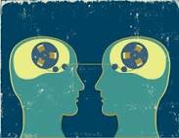
Motivational Interviewing: 4 Principles
(Miller & Rollnick, 2002)
Express Empathy
Develop Discrepancy
Roll with Resistance
Support Self-efficacy

Slide 64
Best Practices for Assessment
Do not re-traumatize!
Do consider the role of shame
Do be genuine, build rapport from the first greeting
Do ask open-ended questions
Do be non-judgmental
Do make use of the stop sign when appropriate
Do assure the client that they may not be alone in their experiences (if appropriate)
Do have closure strategies ready

Slide 65

Now It’s Your Turn…
Write up a brief case synopsis like the J.R. case:
An actual client (using a pseudonym)
A composite client
A “famous” example (presenting for clinical attention)
A fictitious case

Slide 66

Discussion:
Your Reactions and Experiences

Slide 67
What is Shame?
Guilt is feeling bad about what you’ve done,
Shame is feeling bad about who you are.
“Shame is the lie that someone told you about yourself.”
-Anais Nin

Slide 68

Empowerment
Encourage that change is possible, no matter how chronic the relapser… be sincere about it (Marich, 2010).
Foster identification as a survivor, not a victim (Hantman & Solomon, 2007)
Notes:
NOTE TO SELF….Address this in terms of the shame piece ☺

Slide 69

It’s the Relationship That Heals
Comes directly from the traditions of Carl Rogers and Irving Yalom
Meta-analyses continue to show that relational factors have a greater impact than technical factors (Norcross, 2002; Duncan, Miller, Wampold, & Hubble, 2009)

Slide 70
Please Return by 1:00pm

Slide 71

TREATMENT

Slide 72

A Client’s Perspective: from Marich (2010)
Fadalia (pseudonym), a recovering heroin addict with complex trauma reflected on where she was at before receiving the integrated treatment that led to her longest sobriety to date (3 years):
“Before [treatment], my feelings, thoughts and experiences were all tangled like a ball of yarn. I needed something to untangle them.”

Slide 74
Putting it Simply…
Cognitive-behavioral therapies primarily target the prefrontal regions of the brain (e.g., thinking, judgment, and willpower).
However, when a person gets activated or triggered by traumatic memories or other visceral experiences, the prefrontal cortex is likely to shut down and the limbic brain (e.g., emotional brain) takes over.

Slide 75

Putting it Simply…
Thus, our therapeutic interventions must address the entire brain.
Simply talking about trauma or addiction can trigger this volatile, limbic region, and if the client has no skills to regulate these intense emotions, a client can be re-traumatized.

Slide 76
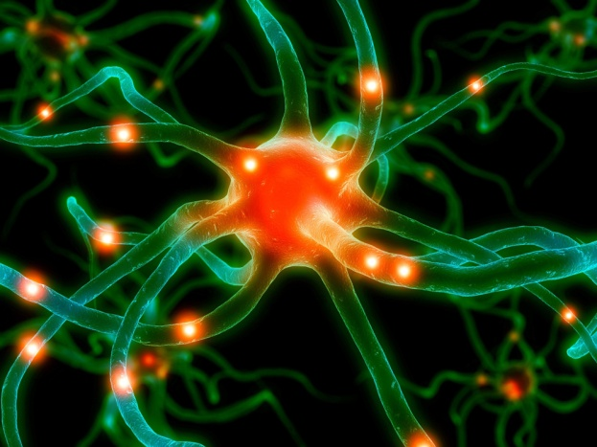
Putting it Simply
What does not seem to change with traditional cognitive therapy is that uncomfortable experience of being triggered at a visceral level, (bottom of the brain) when the person is faced with reminiscent features of the original trauma in the present (Brown, 2003)

Slide 77
So What is the Role of the Professional?
Assist an addicted person build a series of holistic coping skills that help facilitate meaningful lifestyle change

Slide 78

What Types of Coping Skills Work Best???
Muscle relaxation
Breath work
Pressure Points/Tapping
Yoga
Imagery/Multisensory Soothing
Building resources, recovery capital, and support
Anything that incorporates the body in a positive, adaptive way!!!

Slide 79
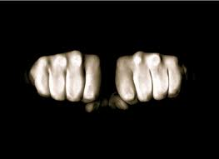
Strategy #1:
Progressive Muscle Relaxation

Slide 80
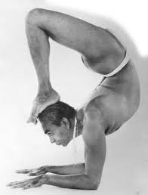
Breathing Basics
”The mind controls the body, but the breath controls the mind.“
B.K.S. Iyengar

Slide 81

Breathing Basics
"Practicing regular, mindful breathing can be calming and energizing and can even help with stress-related health problems ranging from panic attacks to digestive disorders.“
Andrew Weil, M.D.

Slide 82

Breathing Basics
”Teaching breathing exercises to your client is like teaching a teenager when to accelerate and when to brake the car.“
Amy Weintraub

Slide 83

Practicing Awareness of Breath

Slide 84
Strategy #1: Breathing Basics
Diaphragmatic breathing
Complete breathing
Ujjayi breathing

Slide 85


Slide 86
Breathing Basics
Dr. Andrew Weil (2010)
http://www.drweil.com/drw/u/ART00521/three-breathing-exercises.html
Dr. Jamie Marich’s Trauma Made Simple site:
http://www.traumamadesimple.com/videos

Slide 87
Breathing Basics
Clients who are easily activated may not feel comfortable closing their eyes during breath work. Reiterate that it is not necessary to close the eyes during these exercises.
Start slowly…if a client is not used to breathing deliberately, don’t overwhelm him. Starting with a few simple breaths, and encouraging repetition as a homework assignment, is fine. Consider adding numbers or another grounding element.
If a client has a history of respiratory difficulties, make sure to obtain a release to speak with her medical provider before proceeding.

Slide 88
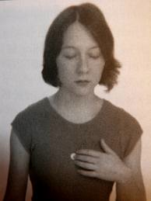
Strategy 3: Pressure Points
Sea of Tranquility
Letting Go/Butterfly Hug
Gates of Consciousness
Third Eye (and variations)
Karate Chop

Slide 89

Yoga: Hype or Hope?
Dr. Bessel Van Der Kolk is a leading research proponent of using yoga as a primary and adjunctive treatment for PTSD
Yoga, if integrated safely and appropriately, is at very least, an ideal coping skill technique in traumatized and/or addicted individuals
Many high profile addiction treatment centers throughout the world offer yoga…this is making its way to grassroots programs as well.
Y12SR, Recovery 2.0, Yoga of Recovery, and S.O.A.R. are all growing programs in this area

Slide 90

Yoga (Union)
Recommendation:

Slide 91

Yoga (Union)
Recommendation:
Yoga and the Twelve Step Path
By Kyczy Hawk
Website:
www.yogarecovery.com

Slide 92
Guided Imagery
The purpose of guided imagery as a stabilization coping exercise is to provide the client with a safe, healthy mental escape that he/she can access when needed
If you do not feel comfortable to develop your own guided imageries, there are many free scripts available online, use with caution to context
Avoid “place” guided imageries until you see how a client is going to respond

Slide 93
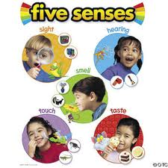
Variations Other Than Imagery
Sound
Smell
Touch/Tactile
Taste

Slide 94


Slide 95


Slide 96

Strategy #5: Mindfulness
Mindfulness means paying attention in a particular way: on purpose, in the presence of the moment, and non-judgmentally.
-Jon Kabat-Zinn (1994)

Slide 97

Strategy #6: Acceptance
- acceptance as Buddhist principle
- 12-step recovery (Alcoholics Anonymous, 2001; p. 417)
-”radical acceptance” (from Dialectical Behavior Therapy)
-Acceptance and Commitment Therapy

Slide 98
Strategy #7: Recovery Capital
Recovery capital: the sum total of the internal and external assets that one can use to acquire recovery and ultimately sustain it (Granfield & Cloud, 1999; White & Kurtz, 2006)
What are some prime examples of “recovery capital”???

Slide 99

Strategy #7:
Recovery Capital
Positive sober support figures
Basic needs (food, shelter, income)
Exercise/use of physical skills (e.g., breathing)
Motivation for sobriety
Coping skills
Living in a safe environment

Slide 100
BREAK TIME

Slide 101
So What Is The Role of the Professional?
Develop an individually-tailored treatment plan to facilitate the lifestyle changes that are needed for meaningful recovery

Slide 102

The Life Style (Alder, 1931)
Patterns form in childhood as a way to cope with any feelings and beliefs of inferiority that emerge
The pair of glasses through which an individual sees the world, glasses that we have designed to deal with our feelings of inferiority

Slide 103
So, What Works for Addiction Treatment?
A meta-analysis examining all studies on bona fide treatments for alcohol dependence and abuse (e.g., CBT, 12-steps, PDT, Relapse Prevention therapy) conducted between 1960-2007 found no statistical significance amongst the treatments (Imel, Wampold, Miller, & Fleming, 2008).
The only factor leading to any statistically significant impact was therapist allegiance.

Slide 104

SAMHSA
For many professionals, the “gold standard” of what constitutes an evidence-based practice or promising practice is one that is catalogued by SAMHSA:
http://www.nrepp.samhsa.gov/

Slide 105
From the American Psychological Association (2006)
An evidence-based practice in psychology is “the best available research with clinical expertise in the context of patient characteristics, culture, and preferences”

Slide 106
NIDA: 13 Principles
No single treatment is appropriate for all individuals.
Treatment needs to be readily available.
Effective treatment attends to multiple needs of the individual, not just his or her drug use.
Treatment needs to be flexible
Remaining in treatment for an adequate period of time is critical for treatment effectiveness.
Individual and/or group counseling and other behavioral therapies are critical components of effective treatment for addiction.

Slide 107
NIDA: 13 Principles
Medications are an important element of treatment for many patients
Addicted or drug-abusing individuals with coexisting mental disorders should have both disorders treated in an integrated way.
Medical detoxification is only the first stage of addiction treatment
Treatment does not need to be voluntary to be effective.
Possible drug use during treatment must be monitored continuously.
Treatment programs should provide assessment for HIV/AIDS, hepatitis B and C, tuberculosis and other infectious diseases
Recovery from drug addiction can be a long-term process

Slide 108
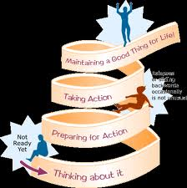
The Stages of Change
(Prochaska, Norcross, & DiClemente, 1994)
Precontemplation
Contemplation
Preparation
Action
Maintenance
Termination

Slide 109
Evans & Sullivan (1995):
An Excellent Model for “Tying it All Together”
1.) A large portion of clients presenting for treatment in any setting have a history of trauma. Respecting this history enhances treatment.
2.) Successful treatment of the trauma must include working through memories of the trauma in an experiential way, after the clinician and client have established a foundation of safety and coping skills

Slide 110
Evans & Sullivan (1995):
An Excellent Model for “Tying it all together”
3.) Substance use disorders are a significant part of the clinical picture for a substantial number of survivors of childhood abuse, thus:
-Treatment of the abuse issues that does not address the substance use issues will be ineffective
- Treating only the addiction in those with survivor issues will likely be ineffective

Slide 111
Evans & Sullivan (1995):
An Excellent Model for “Tying it All Together”
4.) The disease model of addiction and conventional 12-step approaches to treatment are productive in treating the addicted survivor of trauma
5.) Treatment models for addicted survivors of trauma must be integrated, and must address the synergism of trauma and addiction. A two-track approach is generally ineffective.

Slide 112

Where Am I at With
Addiction?

Slide 113
For Continued Development
What are my personal barriers with addiction?
What factors may inhibit me from being effective with an addict?
Am I able to treat an addicted individual with dignity? If not, what prevents me?
Do I have an understanding of what masked grief means?
When is the best time to use collaborative referrals?

Slide 114
Tips for Collaborative Referral
Know your limits. Hopefully, all therapists will one day be able to deal with an addicted client and not get “freaked out.” However, if a client is triggering you too much, don’t be afraid to refer.
Network in your local community—get to know who offers what and who seems to be most knowledgeable in trauma and addiction.
The Internet is a treasure trove of resources. Many of the major websites in trauma therapies have data bases listing clinicians around the country who have gone through extra training.

Slide 115

Tips for Collaborative Referral
In making psychiatric referral, get to know the doctors (or nurse practitioners) in your area who have a prudent, balanced approach to medication. It is not wise to send a client who struggles with addiction and trauma issues to a psychiatrist who relies heavily on benzodiazepine prescribing (or use of other controlled substances). However, you do not want to send your client to a provider who is completely closed-off to prescribing appropriate medications to addicts who may benefit from them.

Slide 116
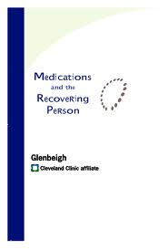
RESOURCE
Medications and the Recovering Person (pdf)
Available at: www.glenbeigh.com
(Under “Resources”)

Slide 117

To contact today’s presenter:
Jamie Marich, Ph.D., LPCC-S, LICDC-CS
Mindful Ohio
jamie@jamiemarich.com
www.mindfulohio.com
www.jamiemarich.com
www.drjamiemarich.com
www.dancingmindfulness.com
www.TraumaTwelve.com
Phone: 330-881-2944

